Slide 1
INTERNSHIP PROJECT PRESENTATION CSE DEPARTMENT
Made by:-Rohan Singh
University Roll No.-2200290100136
Section:-5-C

Slide 2
MLSA Internship
TOPICS:-
Style a basic webpage
Build a simple React application

Slide 3
Style a basic webpage
The title of this project is ‘PG Life’ because it is based on finding nearby paying guests accommodation as per the location ,budget and requirements of the seeker. At PG Life, we empowers you with the tools and information you need to make an informed decision. With a few clicks, you can access detailed listings, high-quality photographs, and essential information about PG facilities and amenities.

Slide 4
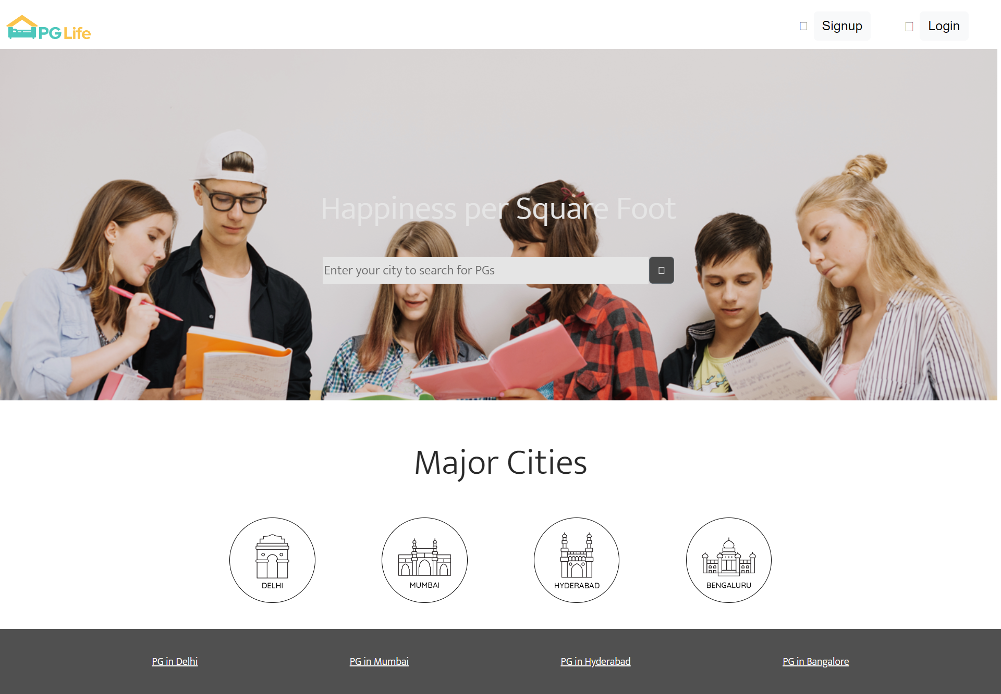
MAIN PAGE OF WEBSITE

Slide 5
Description
The main page of my website contains a search bar where a person can search his PG Accommodation as per his/her convenience. If he/she wants to take a PG in a major city like Delhi, Mumbai, Hyderabad or Bengaluru, then he/she can click on the buttons provided below the search bar that would take him/her directly to the PG’s in these major cities.
The main page of my website is designed using HTML(Hypertext Markup Language) and CSS(Cascading Style Sheets).
HTML provides the structure to the webpage whereas CSS is used to style and animate the page making it presentable and look good.

Slide 6
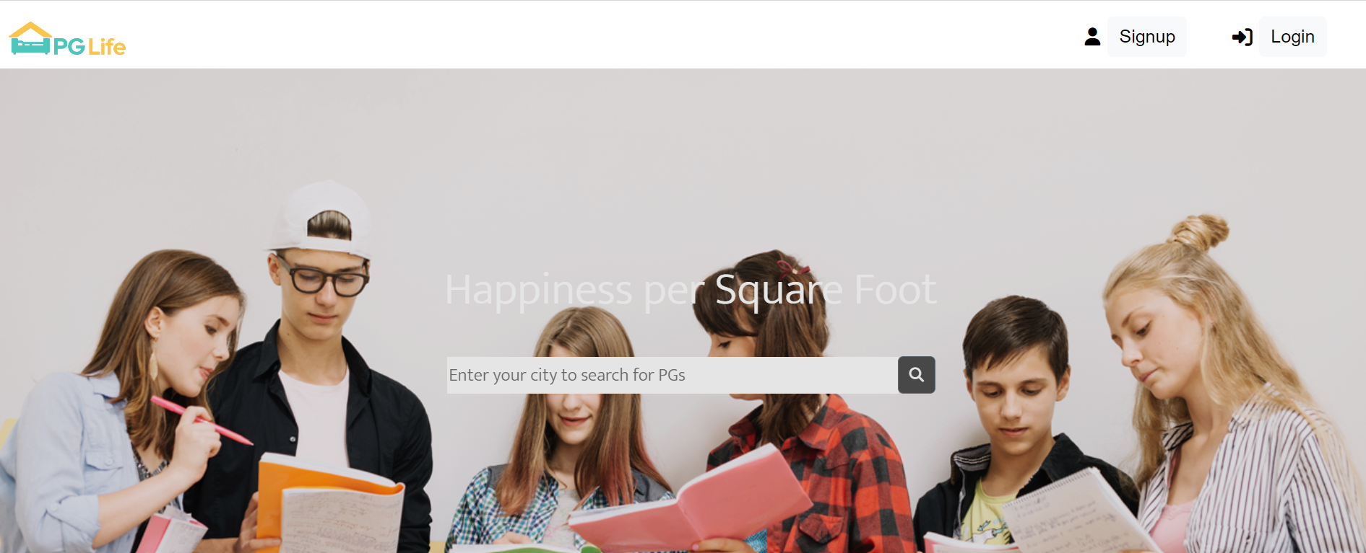
It has a navigation bar on its top that contains the logo and sign up and login buttons using which a user can sign in or login to the website.

Slide 7
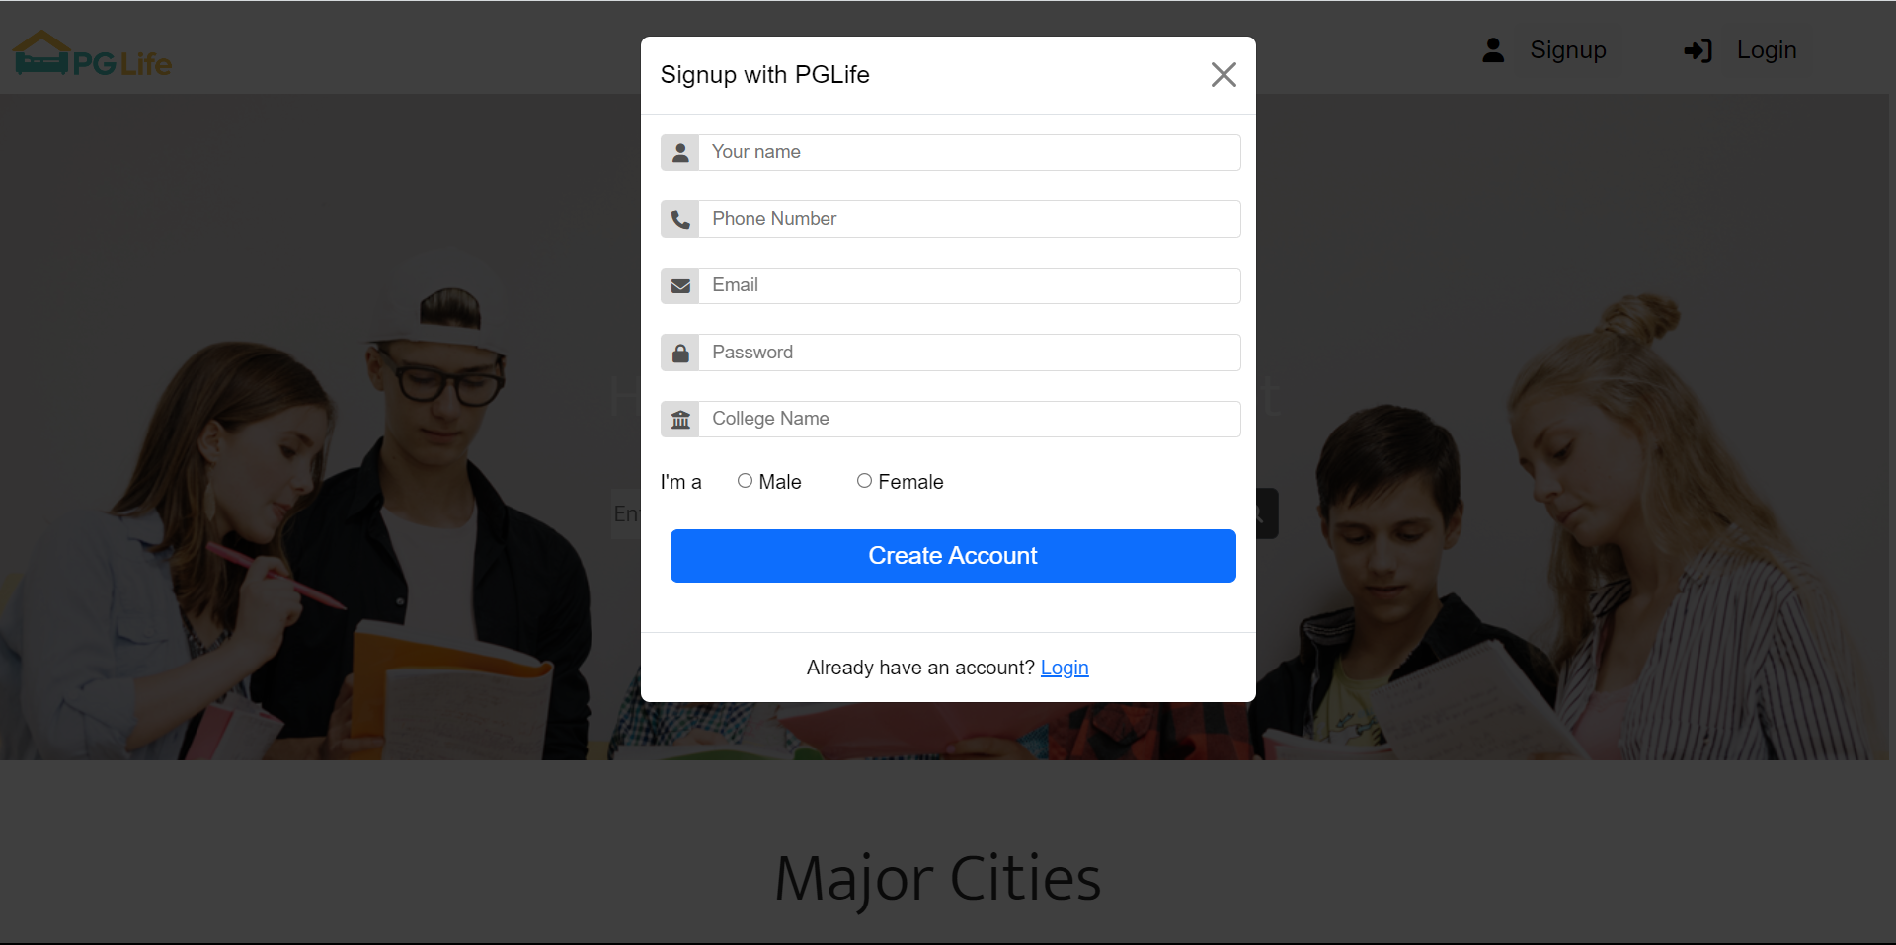
A Signup form appears after clicking on the signup button to create a new account as per the required details that have to be filled.

Slide 8
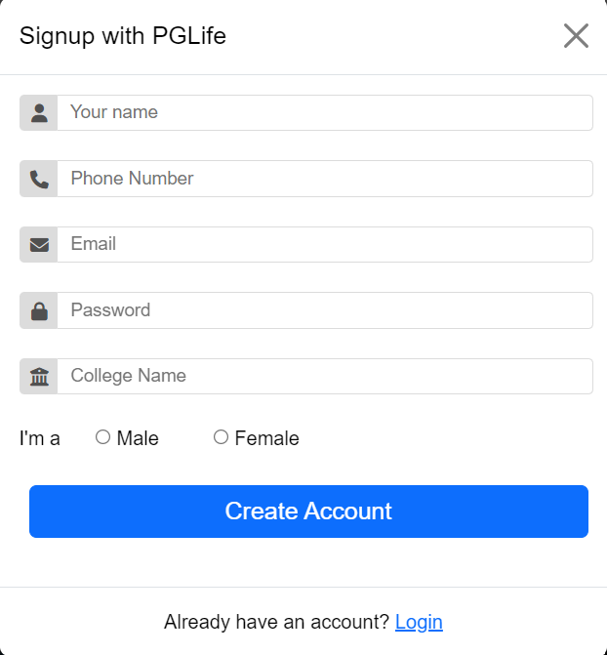
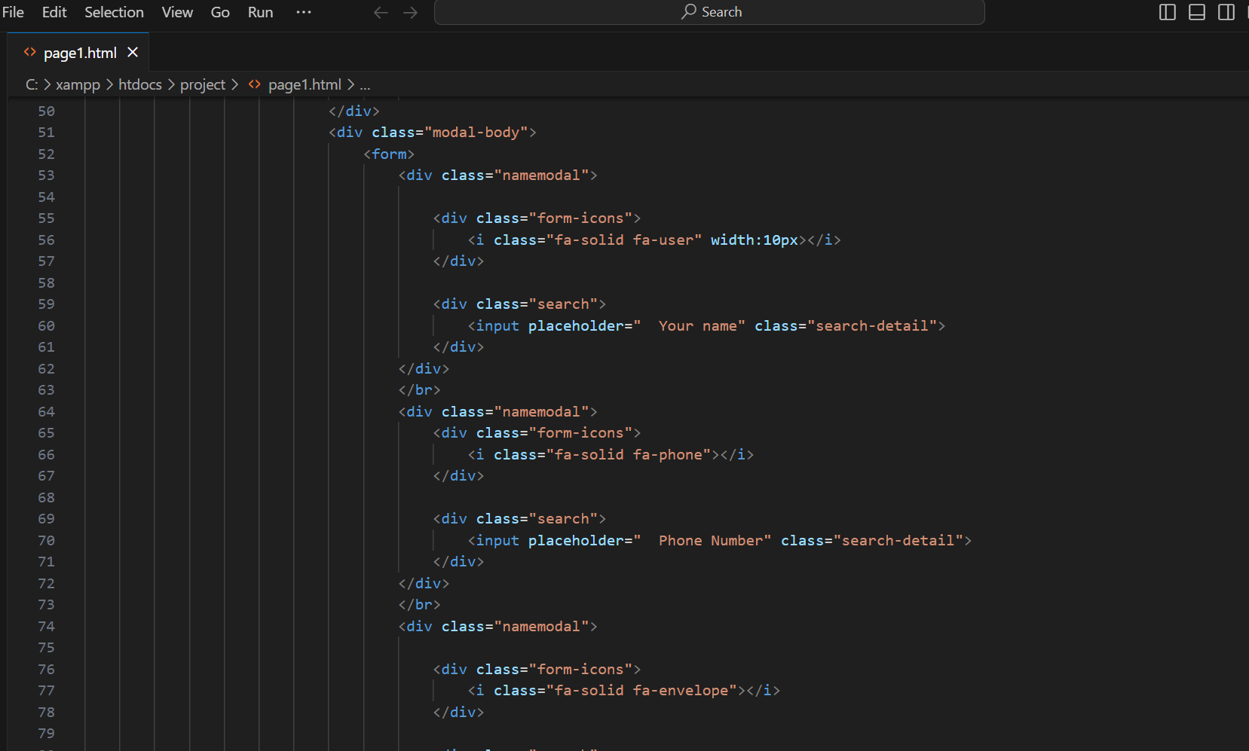
HTML Usage
SIGNUP PAGE
CODE

Slide 9
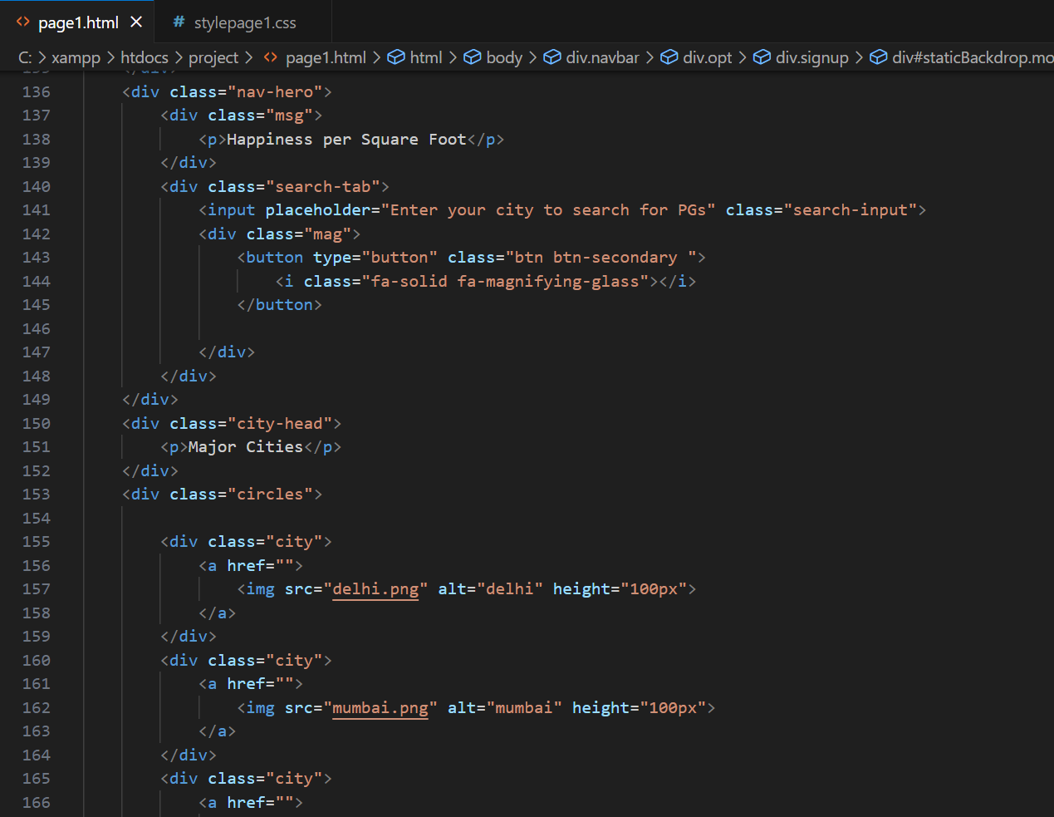
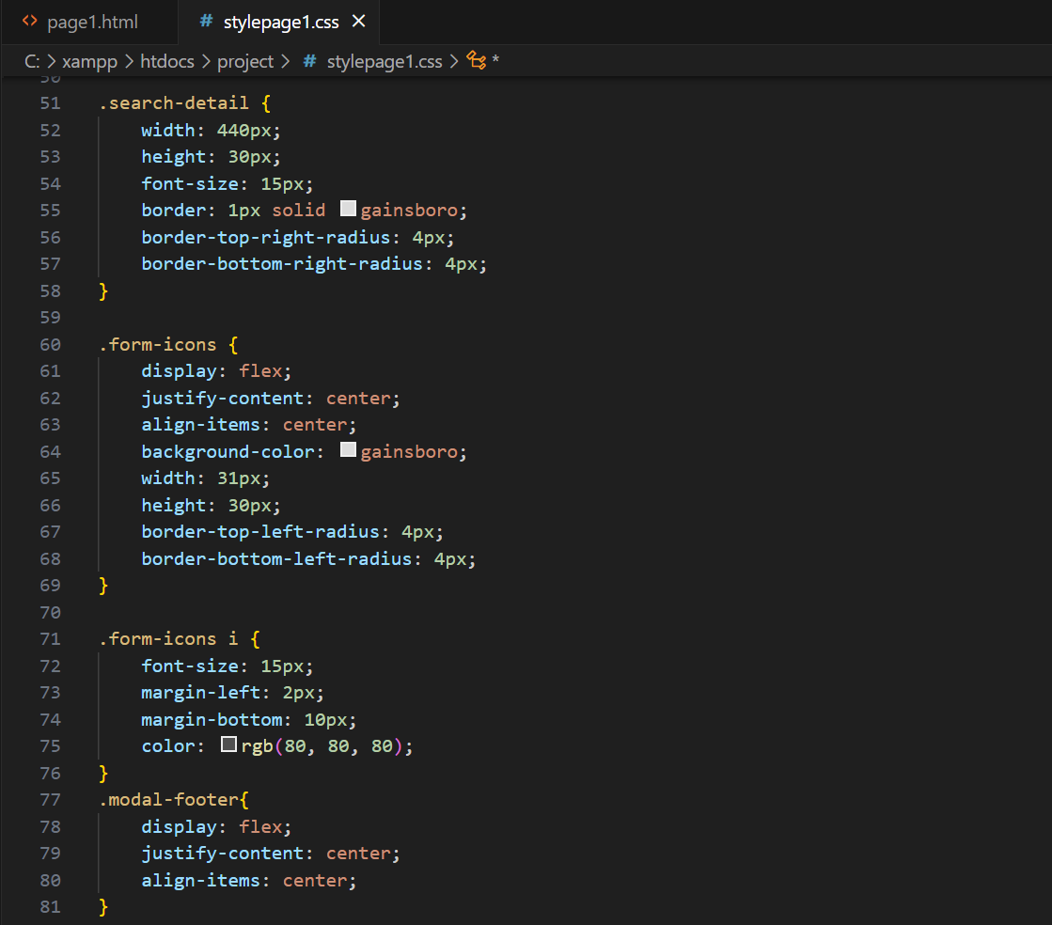
HTML FOR MAIN PAGE
CSS FOR MAIN PAGE

Slide 10
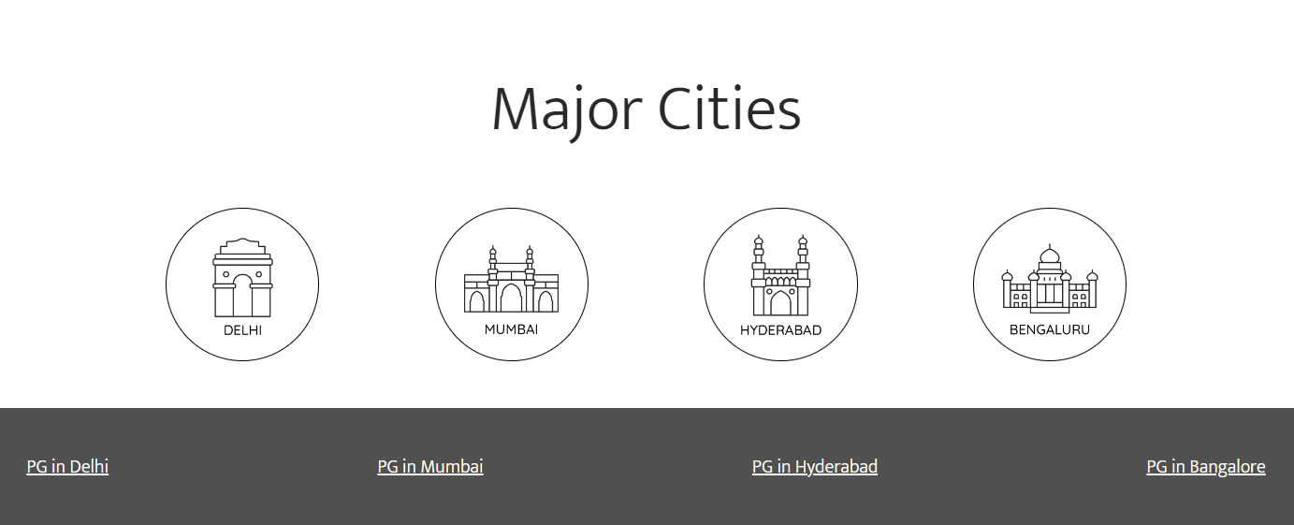
Some buttons and links have been provided at the bottom to minimize a person’s effort while searching for his PG. He/She can directly click on those buttons and links to see the PGs available in that area.

Slide 11
Build a simple React application
The title of this react app is ‘Plan-With-Rohan’. This react app provides a simple interface having different trip plans along with their cost and description of the city. The users who are not interested in a particular trip may remove the trip from their page with the ‘Not Interested’ button.

Slide 12
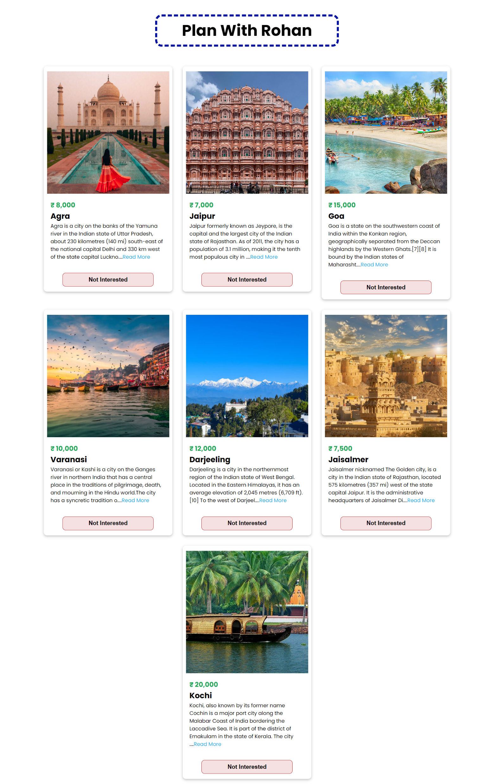
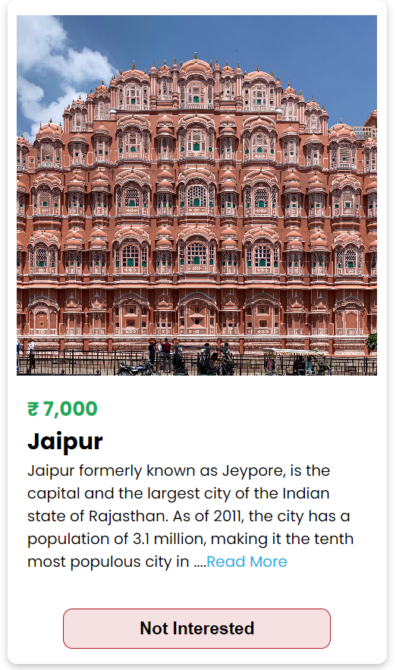

Slide 13

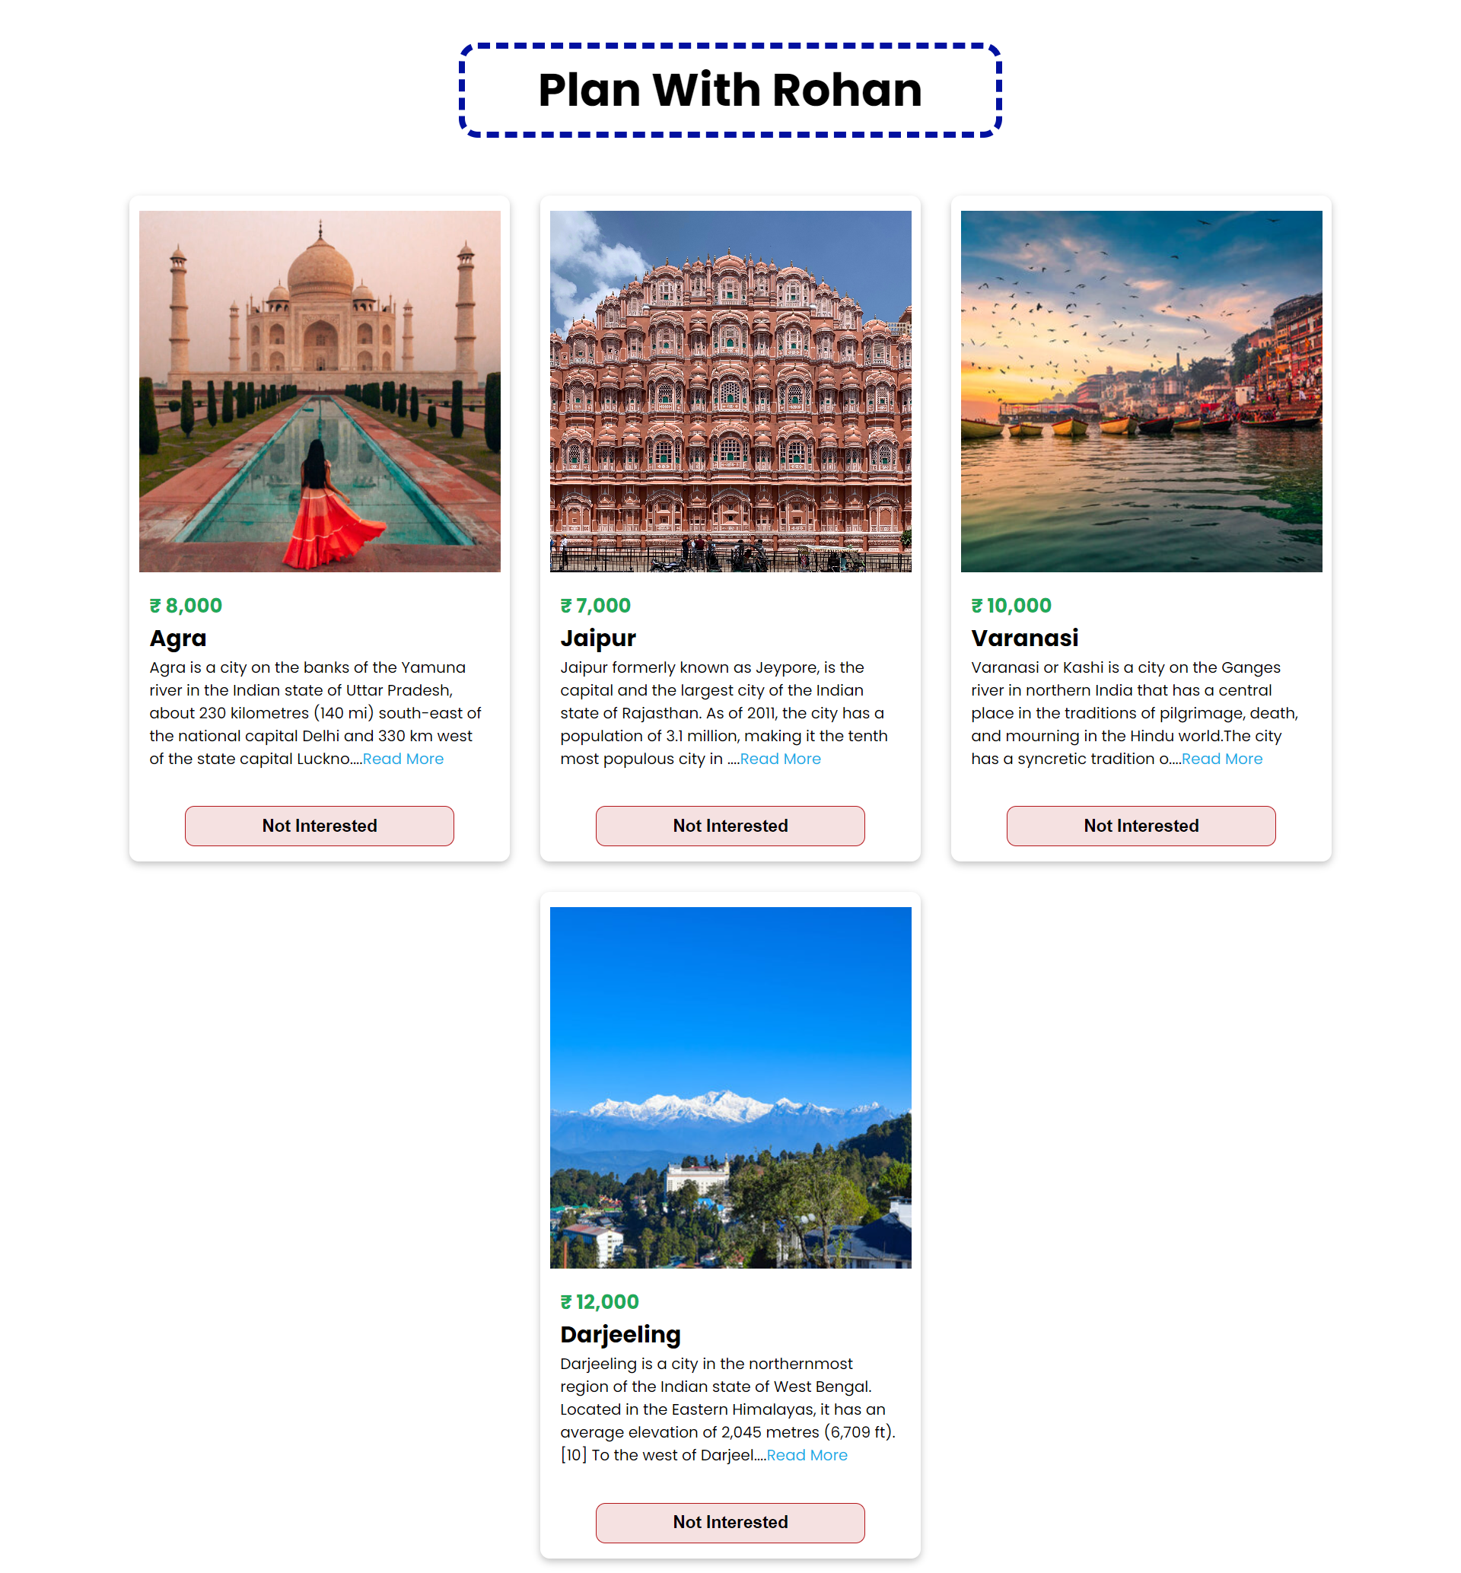
Now, with the help of ‘Not Interested Button the user can remove a trip card from his webpage.

Slide 14


When the user has removed all the trip cards , he will encounter a Refresh Button using which he can get all his trip cards back.

Slide 15
THANK YOU

